Slide 1

Scientific, Technical and Geopolitical
Aspects of Geo-engineering Schemes: Implications for New Zealand
Development of Policy on Geo-engineering

Slide 2
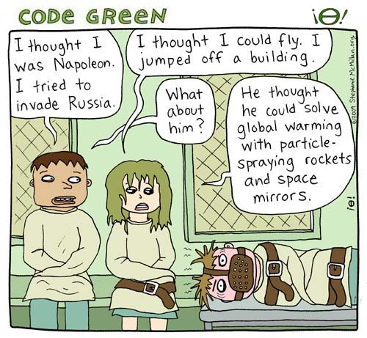
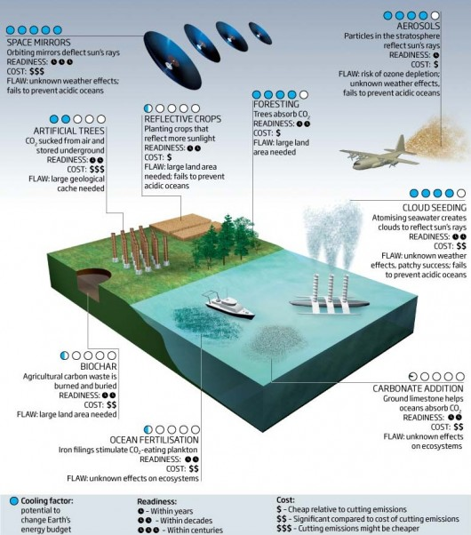
Geo-engineering as a Law & Policy Issue
From (Lunatic) Fringe...
...To Mainstream Science

Slide 3
Geo-engineering as a Law & Policy Issue
The Present...
  Current legal and policy constraints on the development of geo-engineering technologies.
The Future...
  How should geo-engineering technologies be managed in the future?

Slide 4
Discussion: Existing Legal & Policy Constraints
Does current international law regulate or have implications for the development of geo-engineering technologies?
There is little direct regulation of geo-engineering activities with the exception of:
  Forestry projects, which are subject to rules established by the 1992 UNFCCC and the 1997 Kyoto Protocol;
  Sequestration of CO₂ under the seabed, which is subject to the 1996 Protocol to the 1972 London (Dumping) Convention;
  Ocean fertilization projects at the research stage, which are currently under consideration by the parties to the 1996 Protocol to the 1972 London (Dumping) Convention.

Slide 5
Discussion: Existing Legal & Policy Constraints
However, New Zealand has ratified a large number of international treaties and is bound by principles of customary law relating to environmental protection and the conduct of scientific research. These rules may directly or indirectly have implications for the development of geo-engineering technologies.
E.g.
  1982 UNCLOS
  1992 CBD
  1979 CMS
  1992 UNFCCC
  1972 London Convention & 1996 Protocol
  Precautionary Principle?

Slide 6
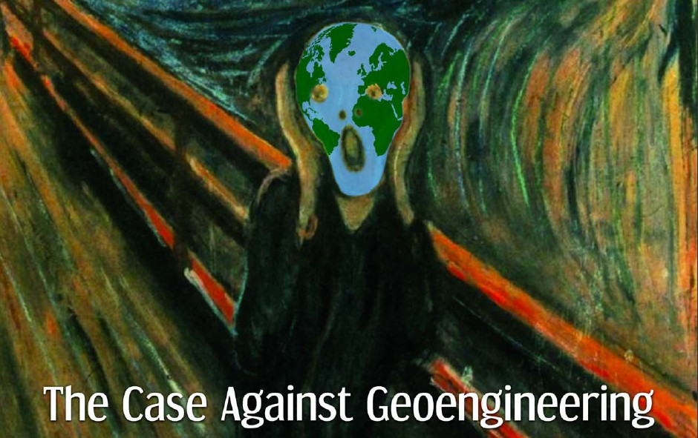
Discussion: The Future of Regulation
Selected Questions
Are geo-engineering technologies qualitatively different from other technologies associated with climate change and, as a consequence, require the development of specialist principles or approaches to regulation? Or, are our existing regulatory tools sufficient?

Slide 7
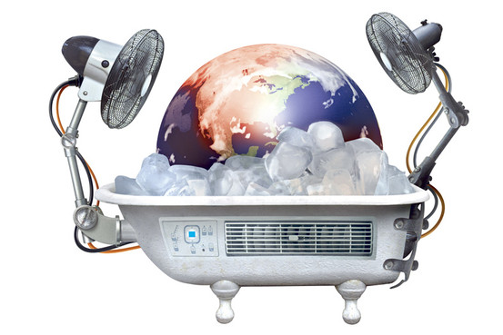
Discussion: The Future of Regulation
Selected Questions
How can we effectively manage geo-engineering technologies in the face of significant scientific uncertainty?
  Does the precautionary principle have a role to play or would it simple stifle all research and innovation?

Slide 8

Discussion: The Future of Regulation
Selected Questions
Who gets to decide whether to engineer the planet to solve climate change?
    Individual states?
    A collective decision?
    An expert decision?

Slide 9
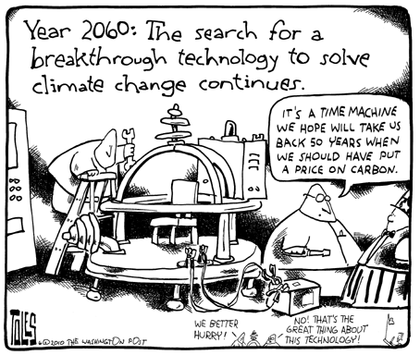
Discussion: The Future of Regulation
Selected Questions
Should decisions to develop geo-engineering technologies be made on a case-by-case basis or should their be some form of overall control at the macro level?
  Do we have appropriate institutions at a national & international level to enable us to achieve this?

Slide 10
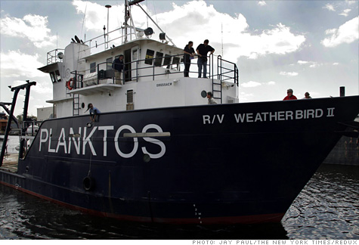
Discussion: The Future of Regulation
Selected Questions
What (if any) role should private corporations and individuals play in the decision to engineer the planet?
  Should corporations be permitted to profit from geo-engineering technologies?

Slide 11

Discussion: The Future of Regulation
Selected Questions
Can we prevent the abuse of climate modification technologies for hostile purposes?
  Is the 1977 Convention on the Prohibition of Military or Any Other Hostile Use of Environmental Modification Techniques fit for twenty-first century purpose?

Slide 12

Discussion: The Future of Regulation
Selected Questions
What is the relationship between engineered technological options and other solutions such as mitigation and emissions reductions?
  Should geo-engineering technologies be included in the Kyoto CDM/ JI mechanisms?

Slide 13

Discussion: The Future of Regulation
Selected Questions
Should we apply, and if so, how do we apply the concepts of state responsibility and individual liability for harm caused by deliberately induced climate modification?

Slide 14
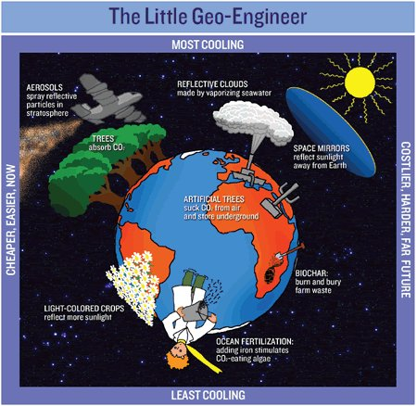
Regulating Geo-engineering:
Management Options
Voluntary Guidelines
Ad hoc regulation by existing bodies and regimes
    Eg IMO and UN Committee on the Peaceful Uses of Outer Space
International Convention on Geo-engineering
Protocol to the 1992 UNFCCC

Slide 15
Proposed Geo-engineering Protocol to the 1992 UNFCCC
Policy; general principles, co-ordination; relationship with other climate change measures
Co-ordinate with UNGA; UNCLOS; UNEP, OSPAR, etc.

