Slide 1
Using the NZ ORCID Hub
New Zealand ORCID Consortium
Dr Alex Freemantle – Kaiārahi ORCID | ORCID Lead 0000-0002-0535-0662

Slide 2
ORCID – The Three Main Services
An ORCID Record – Can include employment, education, funding, professional activities, peer review, research outputs and other metadata
An ORCID iD – A unique, persistent identifier free of charge to researchers
A set of APIs – The service and support that enable interoperability between an
ORCID record and member organisations
Beneficial to researchers, institutions, employers, funders…

Slide 3
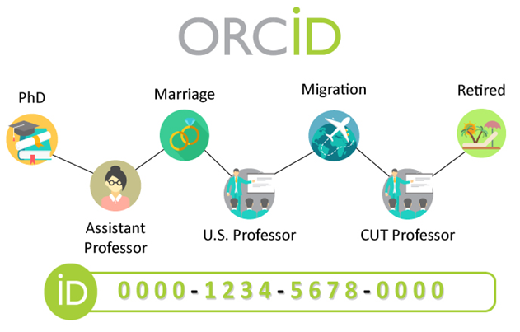
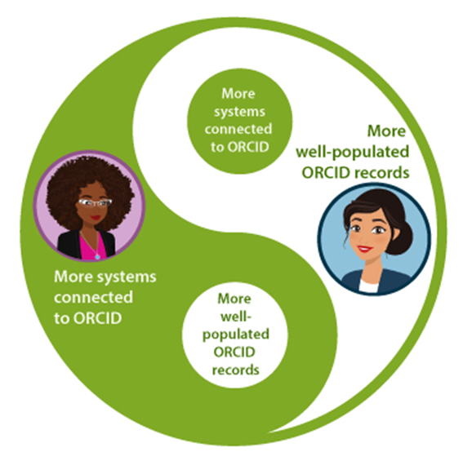
Why write to staff ORCID records?
When able to provide staff with up-to-date ORCID records:
Correctly attributed outputs and affiliations
Reduced administrative burden for staff
Recognise achievements
Improved visibility of outputs
Track outputs and other analytics
Follow researchers’ careers
Interconnected infrastructure

Slide 4

What is the NZ ORCID Hub?
The New Zealand ORCID Hub is a free web application that allows organisations, both large and small, to connect with ORCID to read from and write to their stakeholders' ORCID records, with the record holder's permission.
The Hub saves researchers’ time, as they don't have to update their ORCID record themselves and their records include accurate data from trustworthy sources
The Hub saves organisations money as they do not need to develop costly ORCID integrated systems. Analytics and insights are also provided by the Hub
https://orcidhub.org.nz/

Slide 5
Test Hub and Production Hub
There is a Test (Sandbox) Hub and a Production Hub
Before you have access to the Production Hub you need to be able to demonstrate use of the Test Hub
The Test Hub only makes changes to Sandbox ORCID records, the Production Hub makes changes to real ORCID records
Apply for ORCID Sandbox API credentials for use with the Test Hub and ORCID Member API credentials for use with the Production Hub
Test Hub: https://test.orcidhub.org.nz/
Production Hub: https://orcidhub.org.nz/

Slide 6
Roles in the Hub
There are two role types that staff can be given in the Hub
The individuals in these roles can be different from the ORCID Main and Technical Contacts, but we encourage you to keep them similar
1) Technical Contacts
Only 1 person can be the Technical Contact
They are responsible for storing the API Credentials securely and will have full rights for reading and writing to ORCID records
I can provide access to any new Technical Contacts
2) Administrators
There is no limit to how many staff can be Admins
An Admin has all the same access for reading and writing to staff ORCID records but does not have access to the API credentials

Slide 7
Members Onboarded to the Production Hub
Whitireia & Weltec
Auckland Museum
MBIE
Te Whatu Ora
Eastern Institute of Technology
GNS
BRANZ
Unitec Institute of Technology
Manaaki Whenua
Malaghan Institute of Medical Research
Otago Polytechnic
Lincoln Agritech
Scion
Motu Economic & Public Policy Research Trust
MRINZ
Lincoln University
AgResearch
Massey University
The University of Auckland
Royal Society Te Apārangi
Ara Institute of Technology
University of Otago
ESR
Plant and Food Research
Victoria University of Wellington
University of Canterbury
NIWA
Auckland University of Technology
Onboarded to the Test Hub
LASRA
The University of Waikato
Moana Connect
FERNZ
Notes:
Moana Connect and FERNZ at differing stages of test hub onboarding

Slide 8
Applying for API Credentials
In order to register a client application (e.g. NZ ORCID Hub) you need to apply for and utilise API credentials
For Production Hub Member API Credentials, visit https://info.orcid.org/register-a-client-application-production-member-api/
Use the API Credentials support document on our website for help completing the API credentials application form

Slide 9
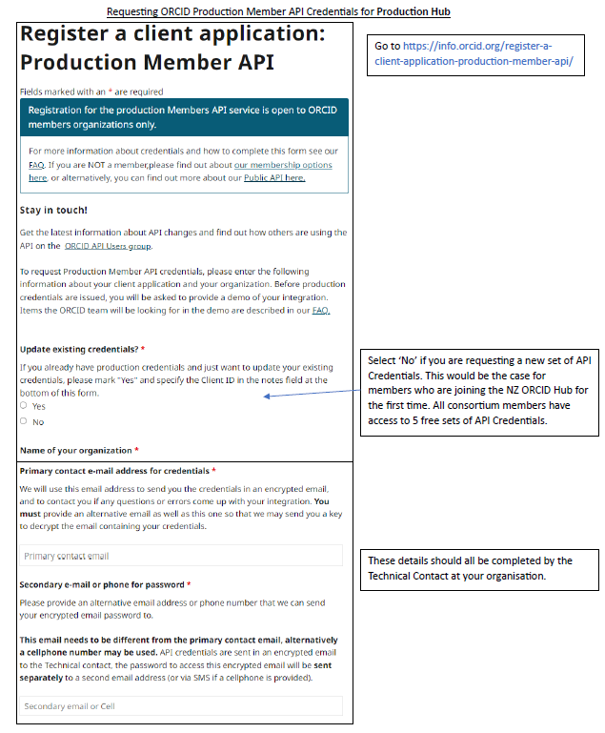
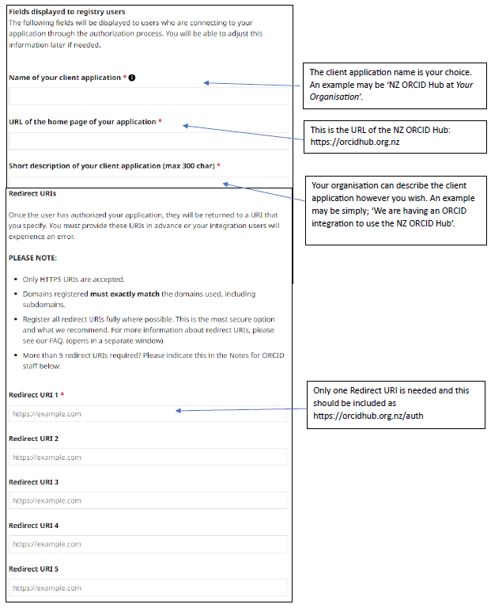
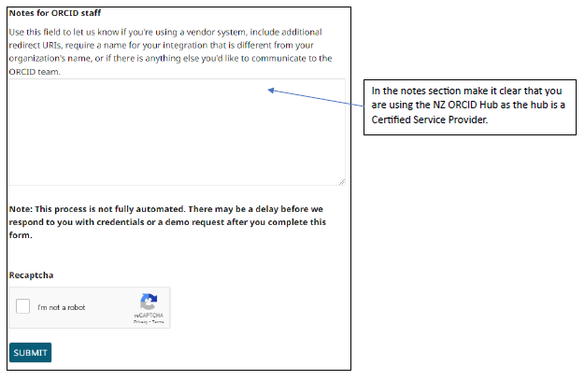
Applying for API Credentials

Slide 10
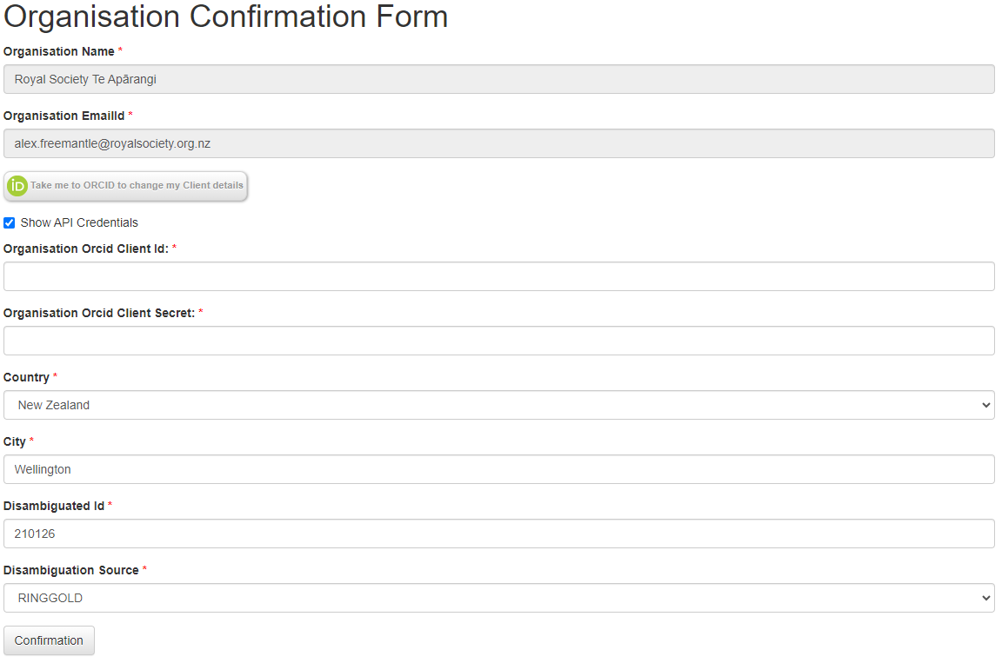
Onboarding to the Hub
You will be sent an email invite to join the NZ ORCID Hub
Follow the link in that email and enter your API credentials into the Organisation Confirmation Form:
Then, you will need to write an affiliation for yourself.
Go to https://orcidhub.org.nz/admin/viewmembers/, find yourself and edit your record to add employment.
Notes:
Once you have your api credentials

Slide 11
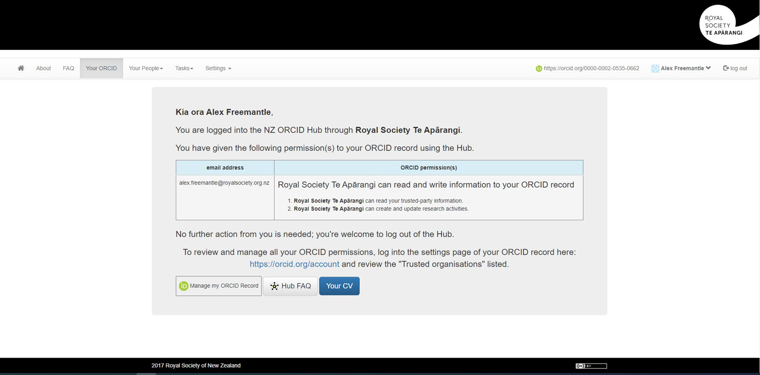
NZ ORCID Hub

Slide 12
NZ ORCID Hub
Information that can be written to your stakeholders’ ORCID records
Employment – Any staff member working/worked at the institution
Education – Any student studying/studied at the institution
Qualifications – All qualifications in progress or completed at institution
Funding – Any funding awarded by the institution through competition
Distinction – Any awards awarded by the institution
Services – A significant donation of time, e.g. Committee work
Invited Positions – Invited non-employment role e.g. Guest researcher
Research Resources – Specialist resources for research
Plus, all other ORCID v3.0 data types

Slide 13
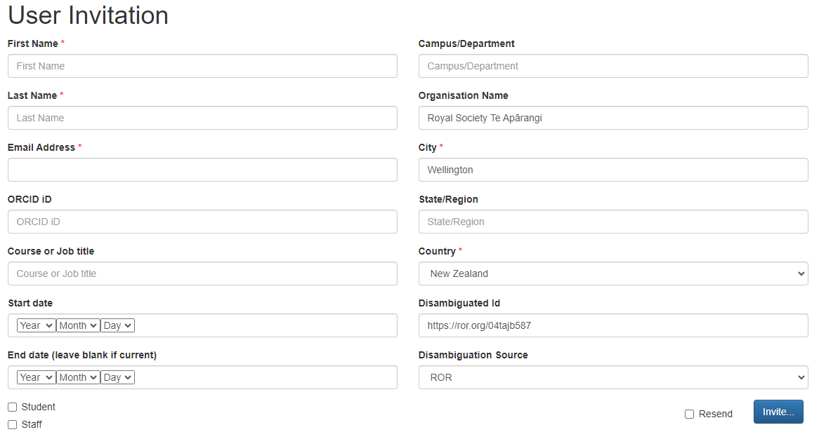
The Process of Writing to Records
Multiple methods: 1) User Invitation
This method is suitable for writing to the record of one member of staff at a time and ensuring that their affiliation is detailed and accurate

Slide 14
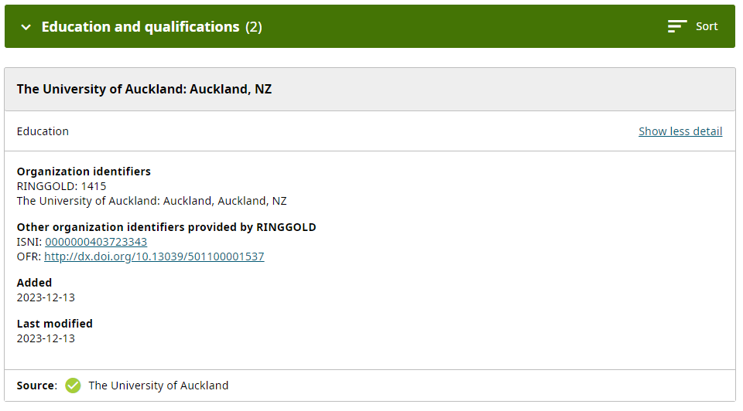
The Process of Writing to Records
Multiple methods: 2) NZ Federated Identity Service: Tuakiri
Only if your organisation is a Tuakiri member.
When an employee or student signs into the hub using their institution Tuakiri log-in details and links their ORCID record, a ‘vanilla’ affiliation is automatically written to their ORCID record.
This vanilla affiliation is accurate but not detailed. The affiliation includes:
Whether the affiliation relationship is employment or education
City (i.e., location of your home campus)
Country (by default New Zealand)
Institution organizational identifier
The source of this information (i.e. your organisation)

Slide 15
The Process of Writing to Records
Multiple methods: 3) Using the NZ ORCID Hub’s API
This method utilises the Hub’s API and you must request API credentials from Royal Society Te Apārangi for use with the Hub
The ORCID Hub API enables automation of everything a Hub Administrator would want to do using the usual user interface
Some NZ ORCID Consortium members make use of this method and can answer questions if you are interested in developing something similar

Slide 16
The Process of Writing to Records
Multiple methods: 4) .json or .csv File Upload
Either json files or csv files can be uploaded via the Task Upload function on the Hub and make changes to the recipients’ records
Json files must be used for more complex record writing such as funding records that have multiple contributors
The files must match the required format and include information in all the required fields
The user guides found on our website demonstrate how the files must be formatted and include template files

Slide 17
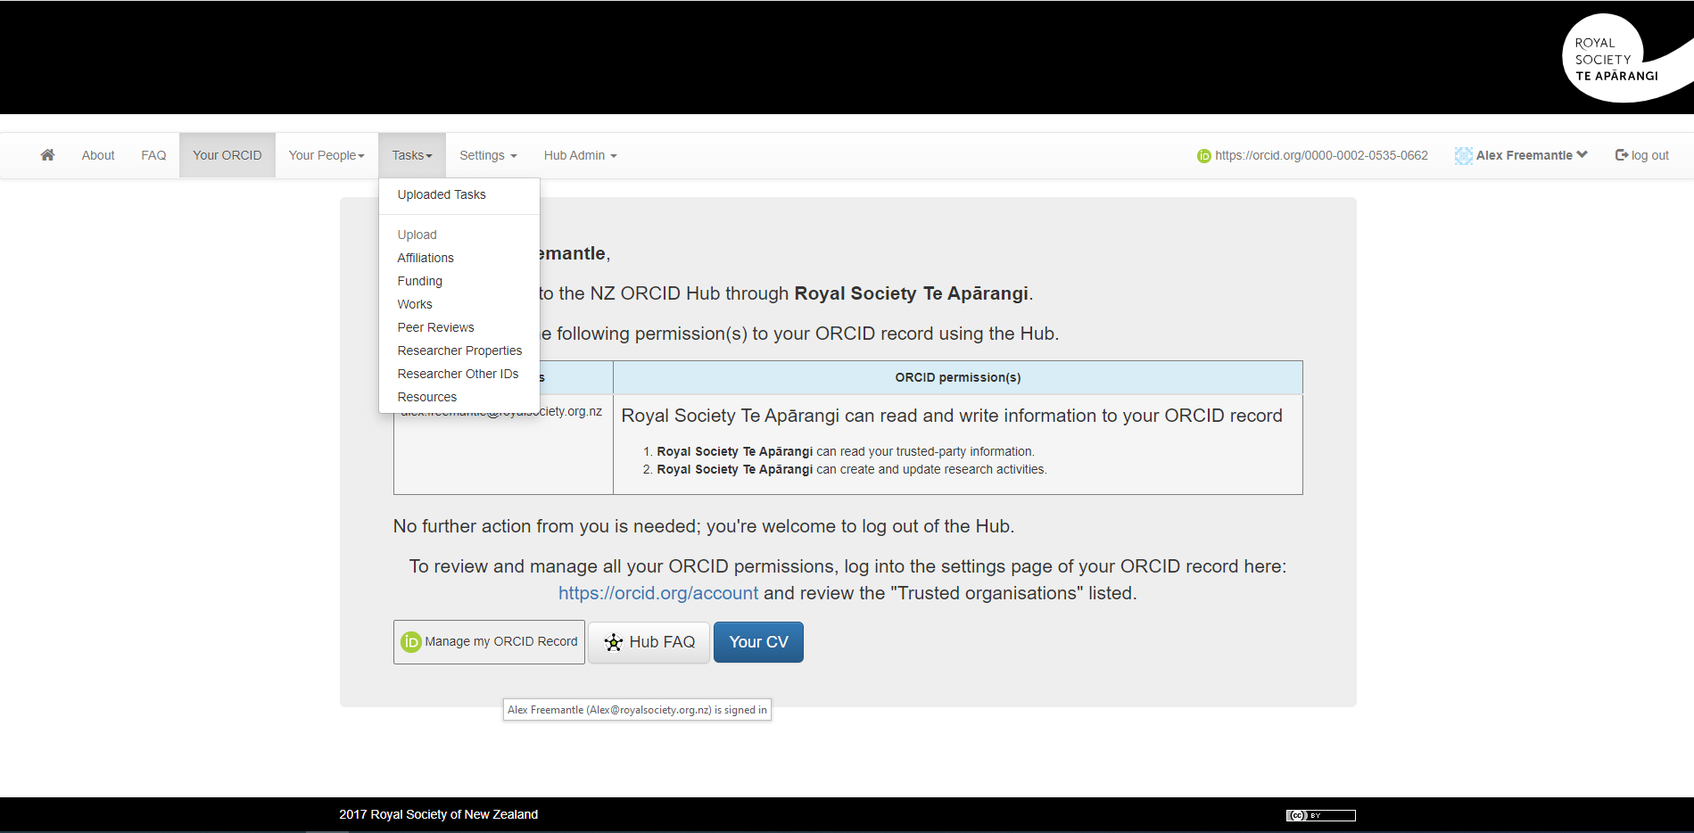
NZ ORCID Hub

Slide 18
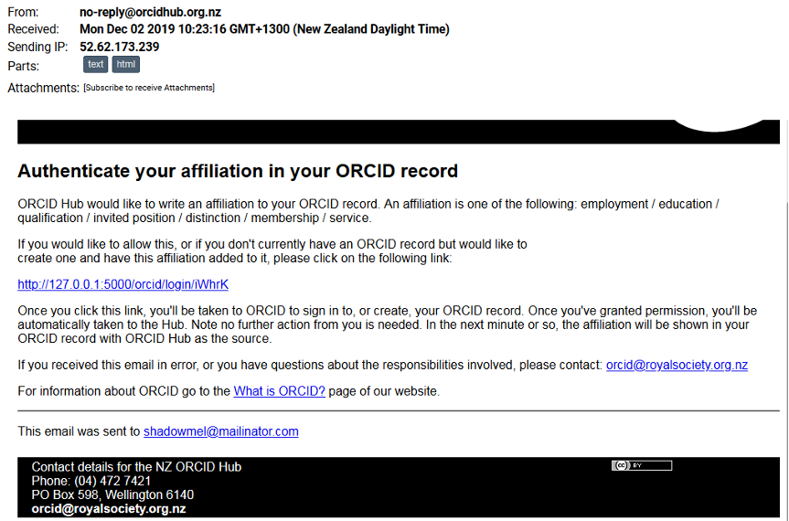
The User’s Experience
When you upload a file through the task upload function or invite the recipient, either:
1) The recipient has already given write permission to the Hub and therefore the information is added automatically to their record
2) Or, the recipient receives an email asking them to log-in to the Hub and give permission to the Hub to make changes to their record.
The data is then added to their record and next time, the information will be added automatically.

Slide 19
Communicating about the Hub
Our process for a recent Distinction writing project:
1) We email all recipients informing them of the imminent writing of information to records and ask them to check that the information is correct. We also use this to check the accuracy of the email addresses. This email is sent 2 weeks before the uploading of information.
2) If any recipient requests to not be involved following this initial email, then they are removed from the file and the information will not be written to their ORCID record.
3) After two weeks, the csv or json files are uploaded to the NZ ORCID Hub and the task is then activated.
4) This activation will trigger the email from the Hub to the recipients to ask for authorisation to write to their record. If the recipient has already allowed the Hub to make changes to their record then the information is automatically uploaded.
5) Recipients are informed that they can make updates to their ORCID record visible only to themselves and have control over their records. They can also ignore the email from the hub and the information won’t be uploaded.

Slide 20
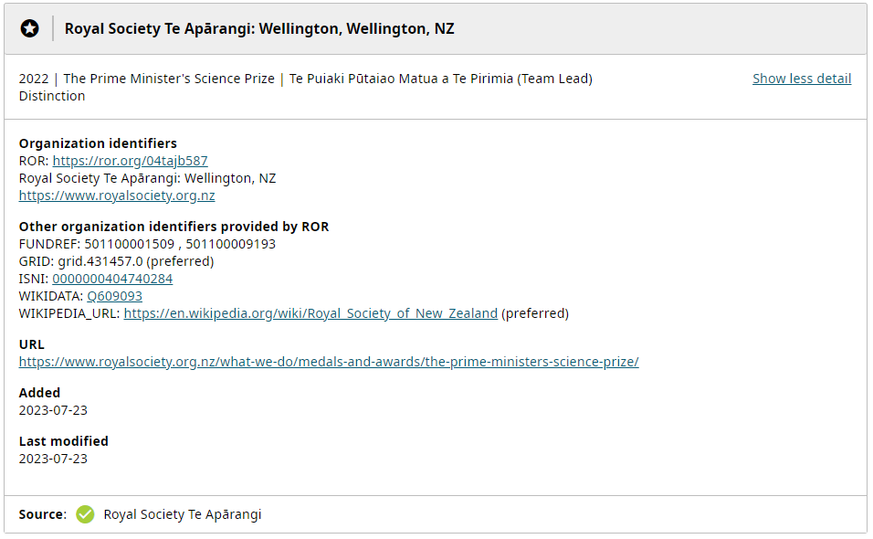
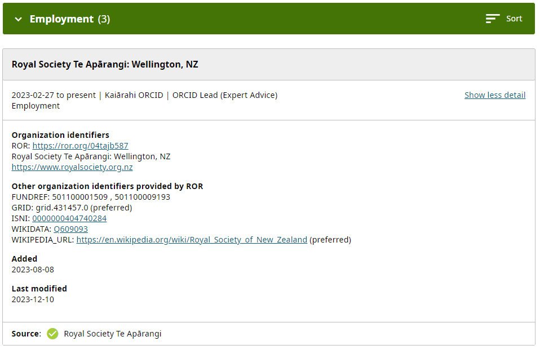
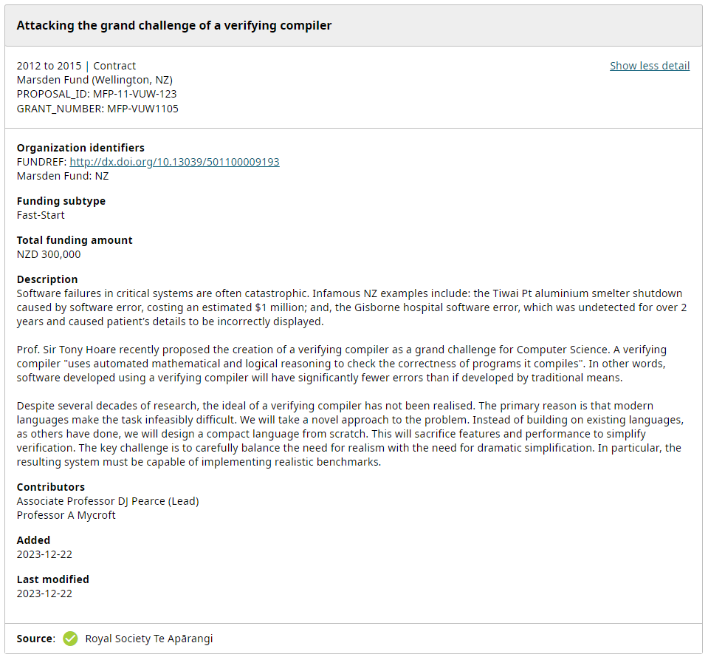
Written examples

Slide 21
Hub usage from Otago Polytechnic
Otago Polytechnic have been writing works information from their journals to ORCID records
The ORCID Hub admin collates the works information into an excel spreadsheet
Then an Excel VBA macro is run which converts the data to a .json file
The .json file is then uploaded to the NZ ORCID Hub and the file is activated
Information is written to the ORCID records of all the contributors for each journal article

Slide 22
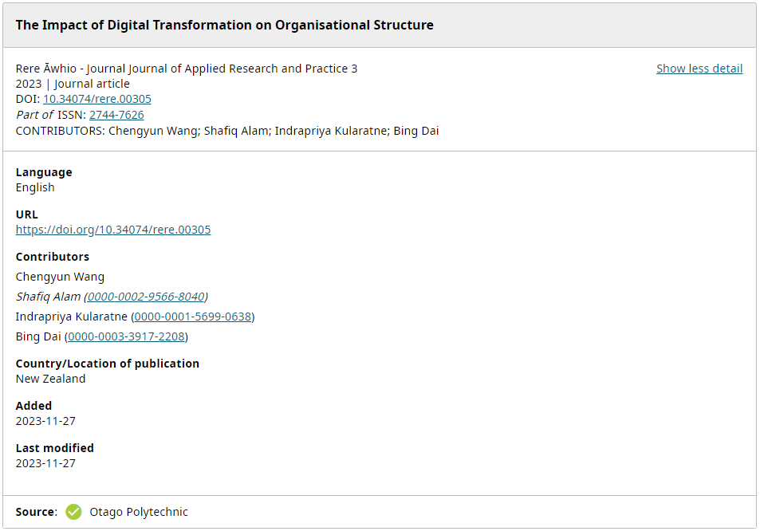
An example record

Slide 23
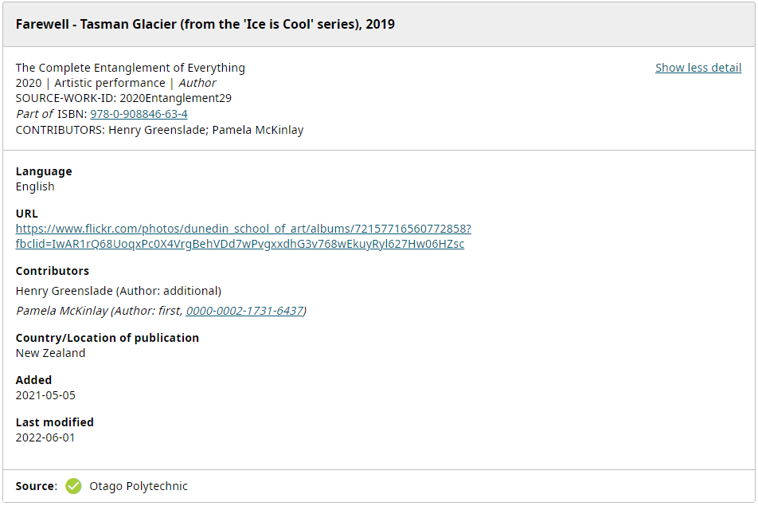
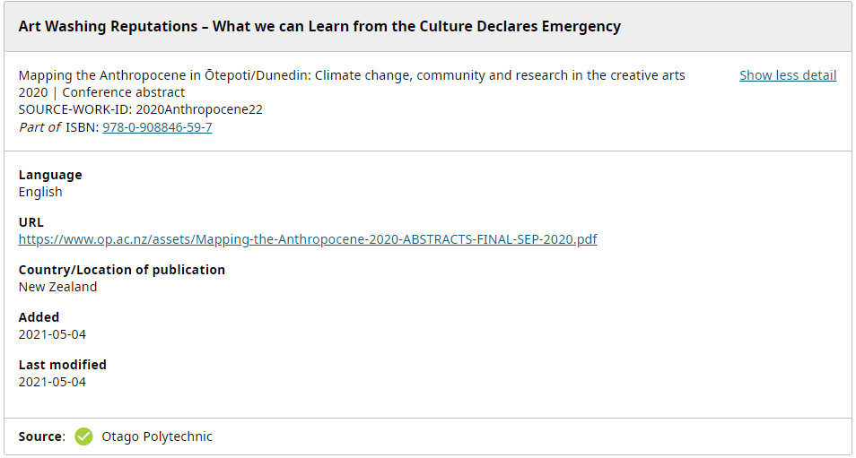
Otago Polytechnic have also written other work types to records

Slide 24
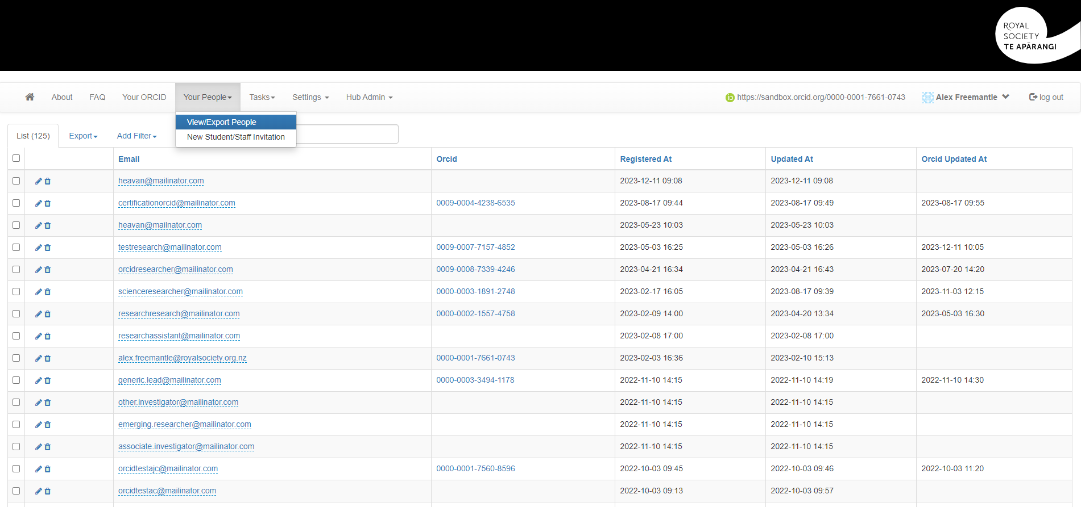
Other functions of the NZ ORCID Hub

Slide 25
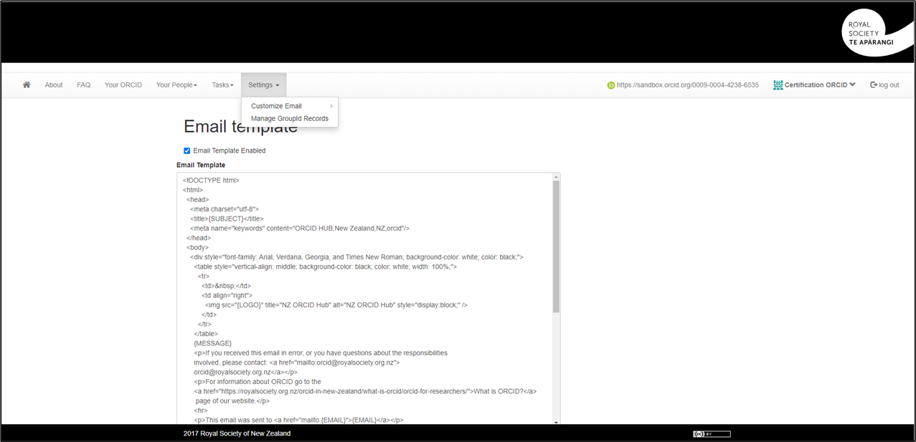
Other functions of the NZ ORCID Hub

Slide 26
Demo
A demonstration of writing an affiliation to a staff member’s ORCID record
https://sandbox.orcid.org/0009-0005-8536-4309

Slide 27
Useful links and Resources
We have a section of our website dedicated to support when using the Hub
This provides information about applying for credentials, onboarding to the Hub and user guides for using the Hub
On this webpage, there are also ORCID Communication examples and advice for developing a communication plan
The Hub FAQ can be found here and here
Some more Hub documentation can be found here, although this is mostly relevant for the v2.0 ORCID schema
A test ORCID Hub swagger can be found here

Slide 28


Any question? orcid@royalsociety.org.nz

